Slide 1

Summer Project
Group 2
Group Members-
Varnika Goel (40821121)
Hardik Vashisht (40821050)
Akshay Singh Adhikari (40821010)

Slide 2
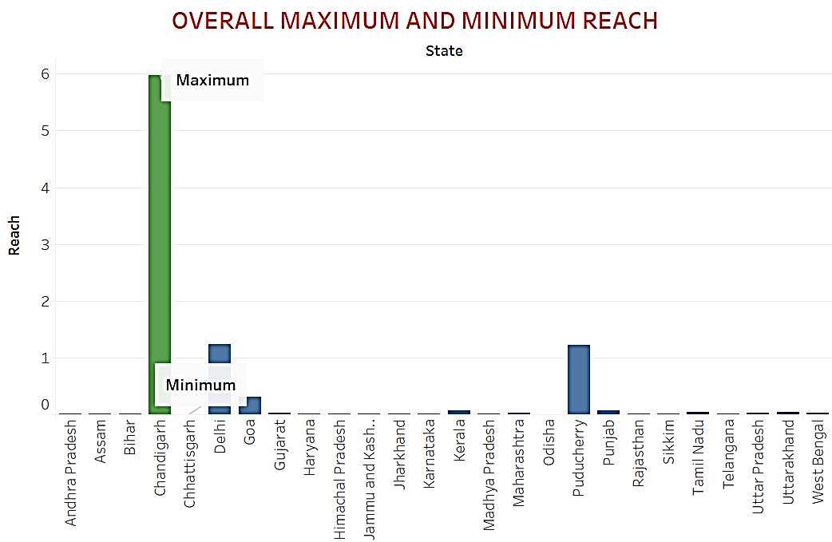
Visualize the reach of Zomato pan India. Which state has maximum reach and which has least reach?
Maximum Reach- Chandigarh
Minimum Reach- Chhattisgarh

Slide 3
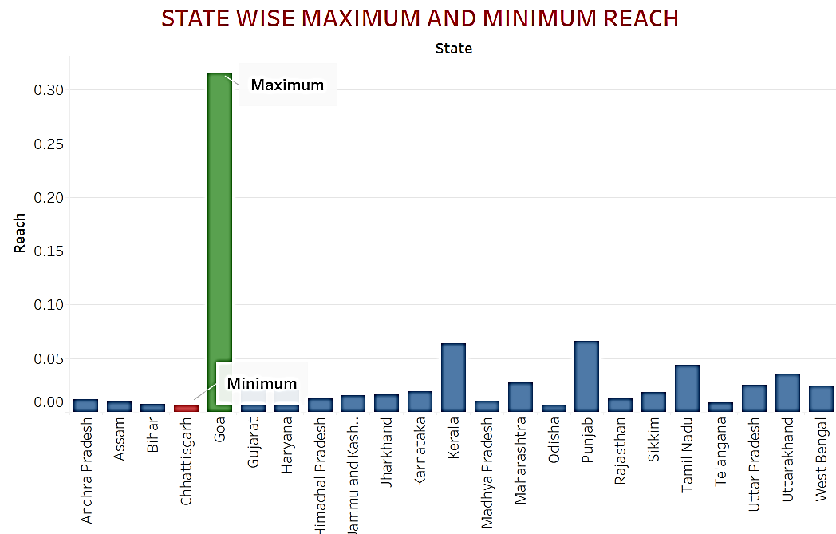
Maximum Reach-
Goa
Minimum Reach- Chhattisgarh

Slide 4
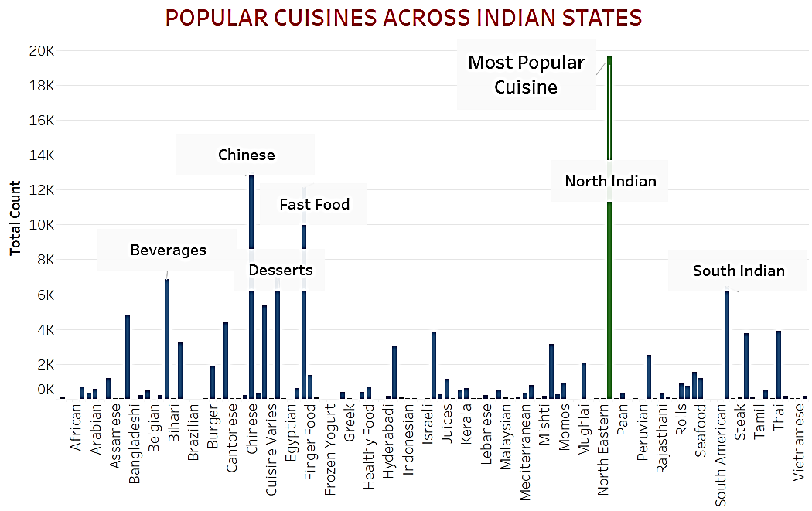
Identify the most popular cuisines across Indian states.
Most Popular Cuisine- North Indian
Other popular cuisines-
Chinese
Fast Food
Beverages
Desserts
South Indian

Slide 5
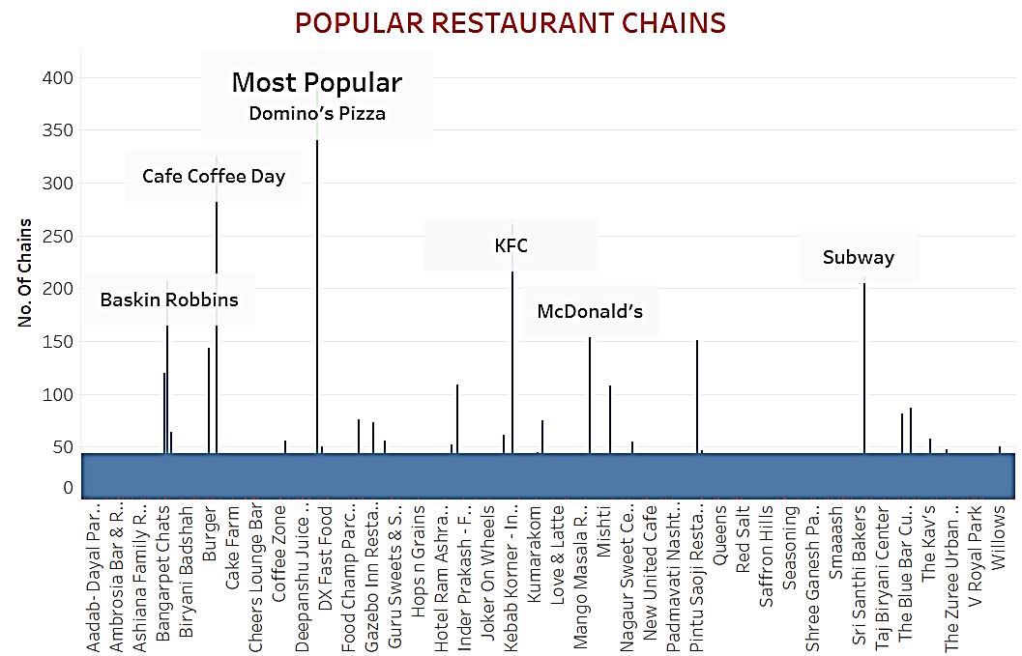
Identify the most popular restaurant chains across Indian states.
Most Popular Restaurant- Domino’s Pizza
Others-
Café Coffee Day
Baskin Robbins
KFC
McDonald’s
Subway

Slide 6
City- RANCHI

Slide 7
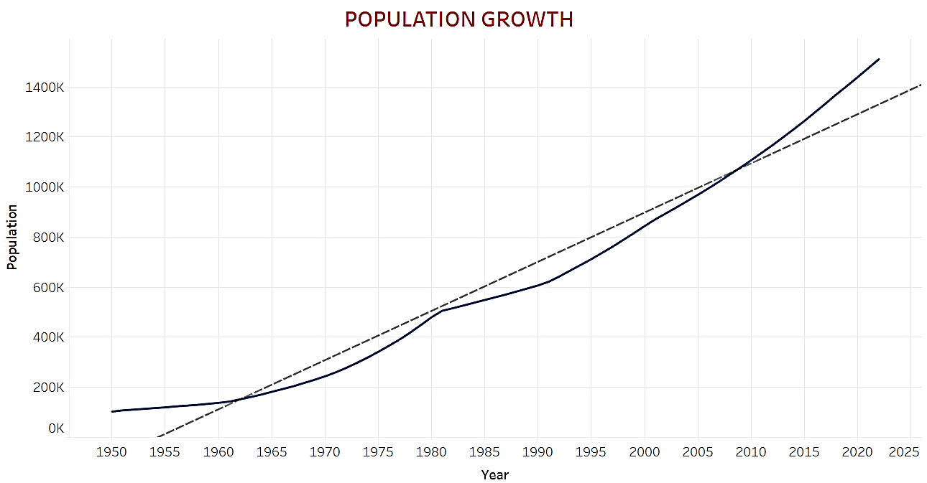
POPULATION GROWTH of Ranchi

Slide 8
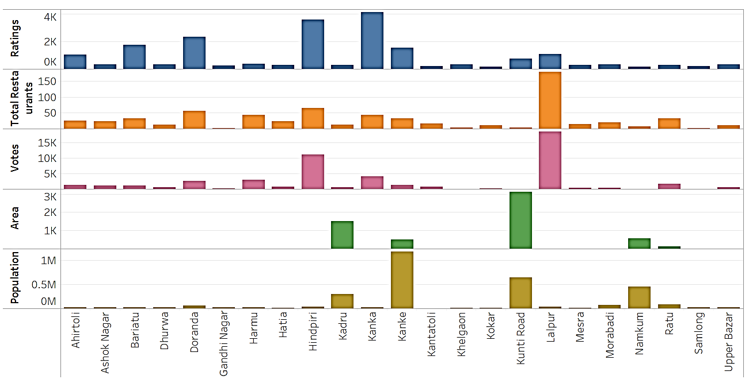
In your city (Ranchi), which locality would you choose for opening your restaurant and why?

Slide 9
CMPDI
Central Mine Planning and Design Institute Limited (CMPDIL) is one of the eight subsidiary of Coal India Limited (CIL) with its headquarters at Ranchi.
The colony is based in the Kanke road.
The colony has a State Bank of India inside the campus.
Gondwana School inside the campus has been run by CMPDI for the last 25 years.
The Colony also has a tennis court, play ground, Community hall and Mayuri hall.
It has a Ladies club (Mahila Sabha) which donates towards blind students at Birsa Blind school.
The colony is 8.7 km from Ranchi Railway Station and 12.3 km from Airport.

Slide 10
KANKE

Slide 11
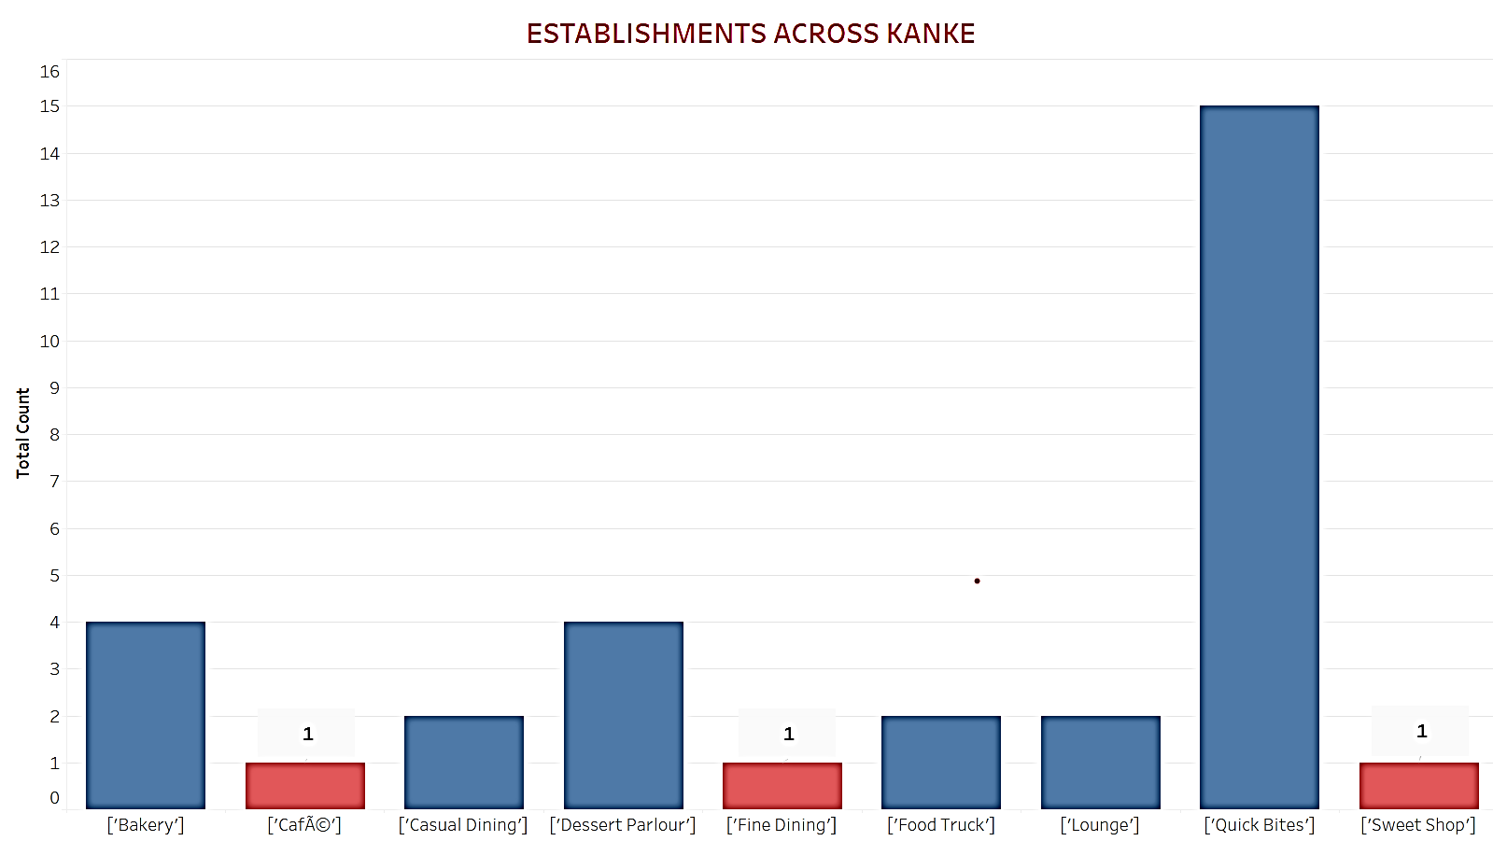
Type of Restaurant
Café
Business meetings (CMPDI, Ladies Club)
Youngsters coming for playing in complex
Residential area nearby
Airport and Railways nearby

Slide 12
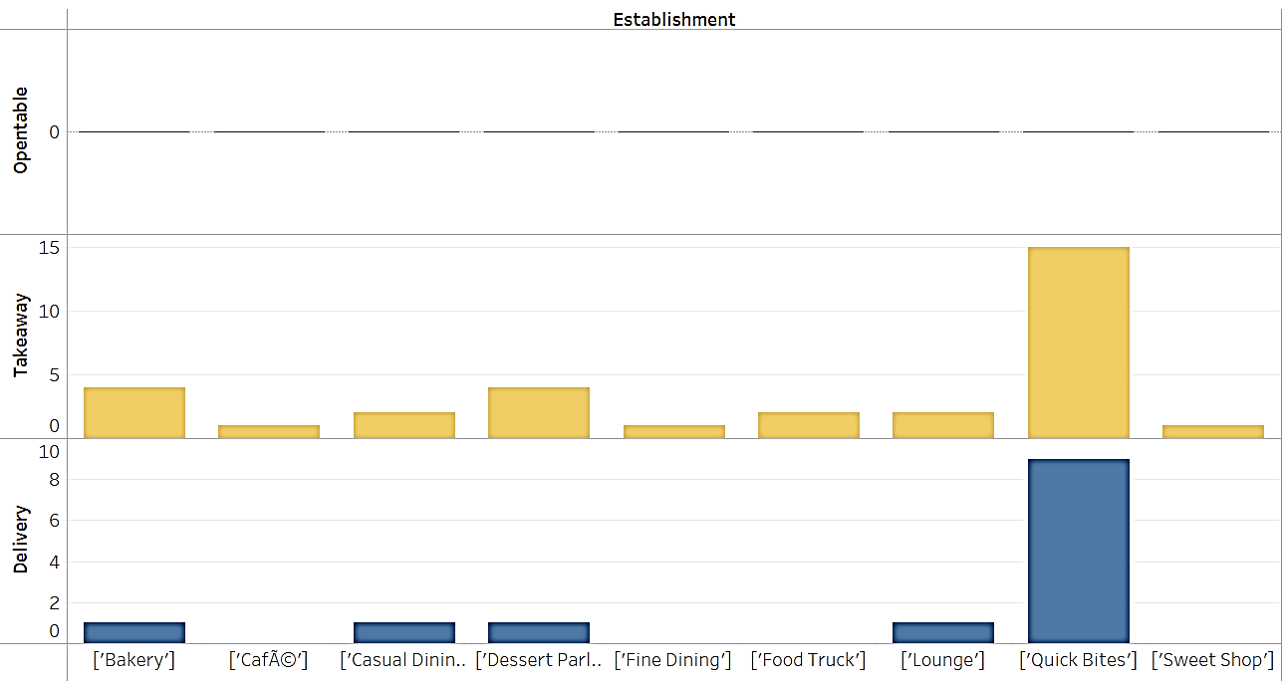
Opentable, Delivery and Takeaway available
We will collab with CMPDI.

Slide 13
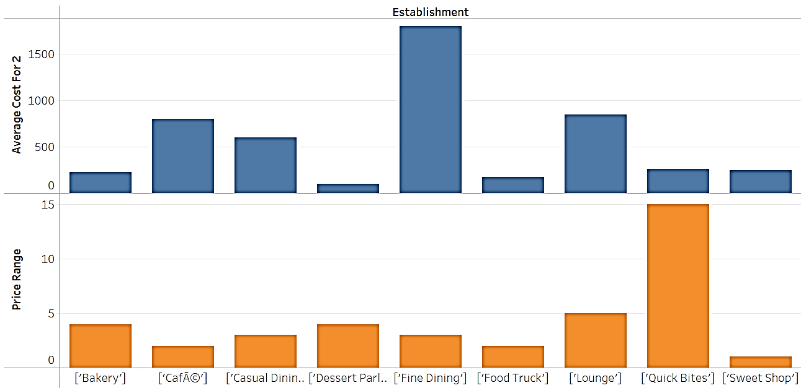
Average Cost for 2: Rs. 500- Rs. 800
Price Range: 5

Slide 14
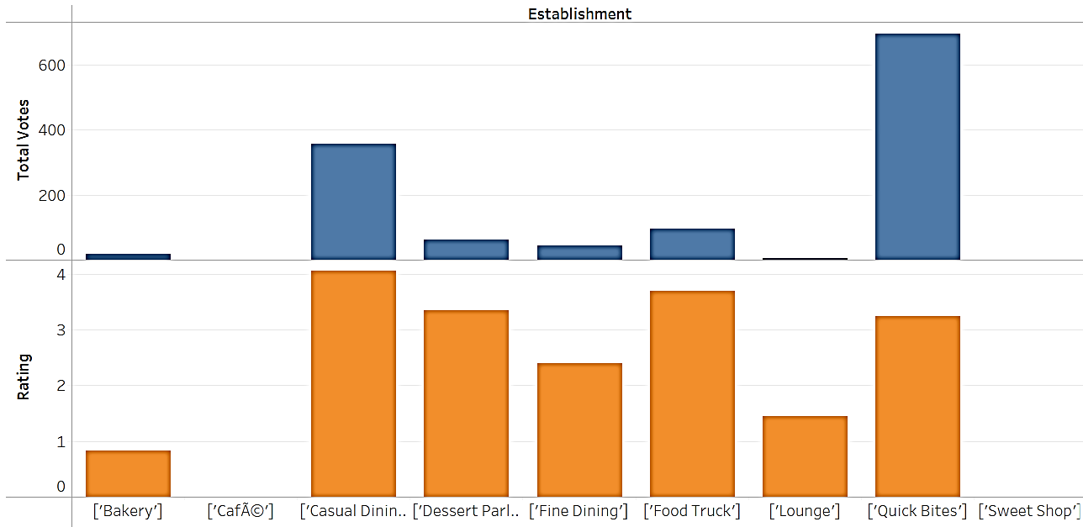
Rating and Votes= 0
The 1 café present is not a success

Slide 15
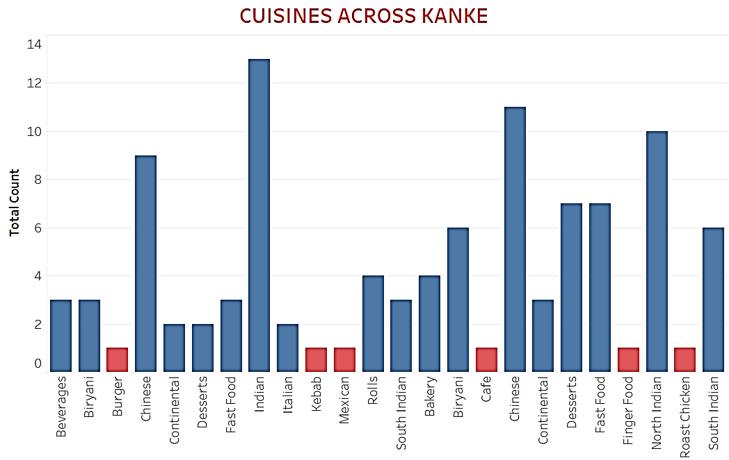
Cuisine Selection
Burger
Café
Finger Food
Beverages
Chinese
Italian
Mexican
Desserts

Slide 16
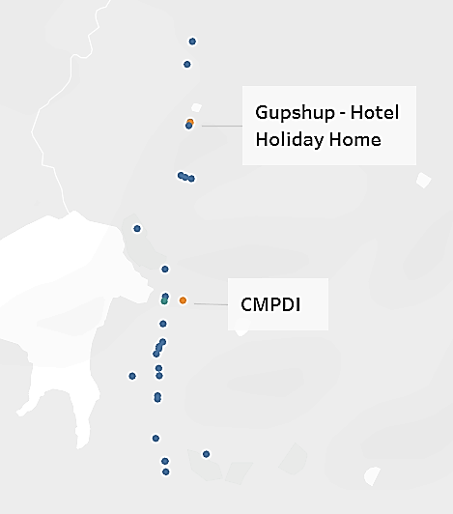
Where would you place your restaurant in this locality (identify the latitude & longitude?
The distance between the present CAFÉ and CMPDI

Slide 17
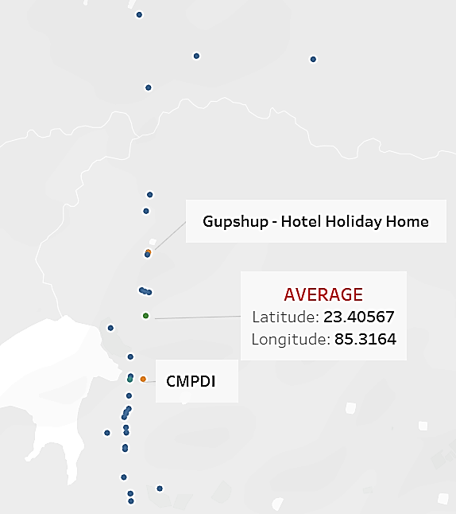
The Central Location between the present Café and the CMPDI

Slide 18
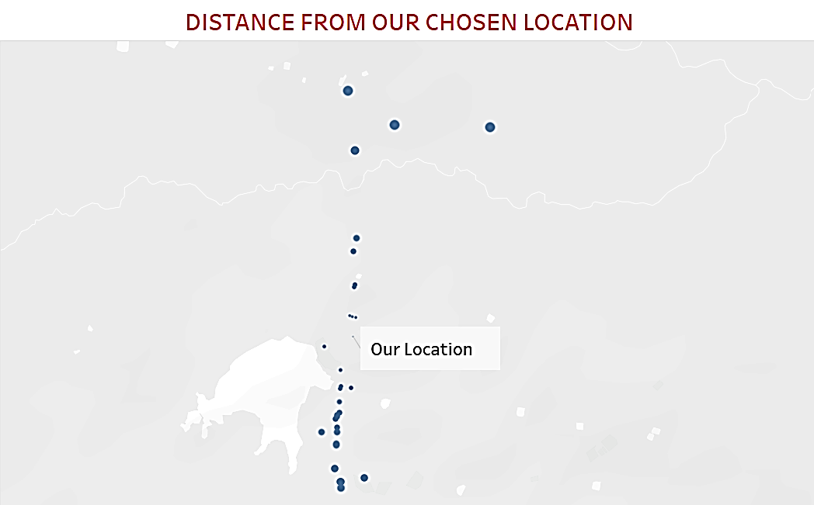

Slide 19
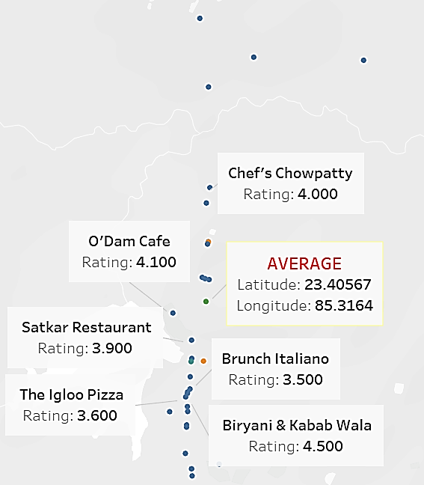
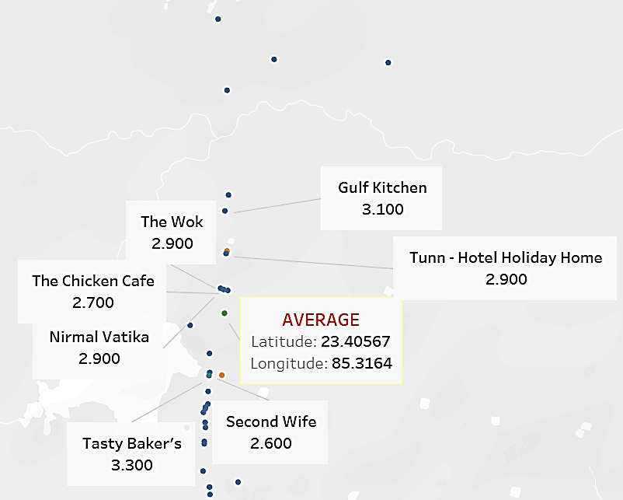
The location chosen has equal number of High and Low Rating Restaurants
People visit this location

Slide 20
Thank you

